Slide 1
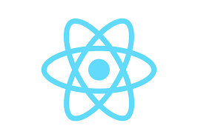
REACTJS

Slide 2
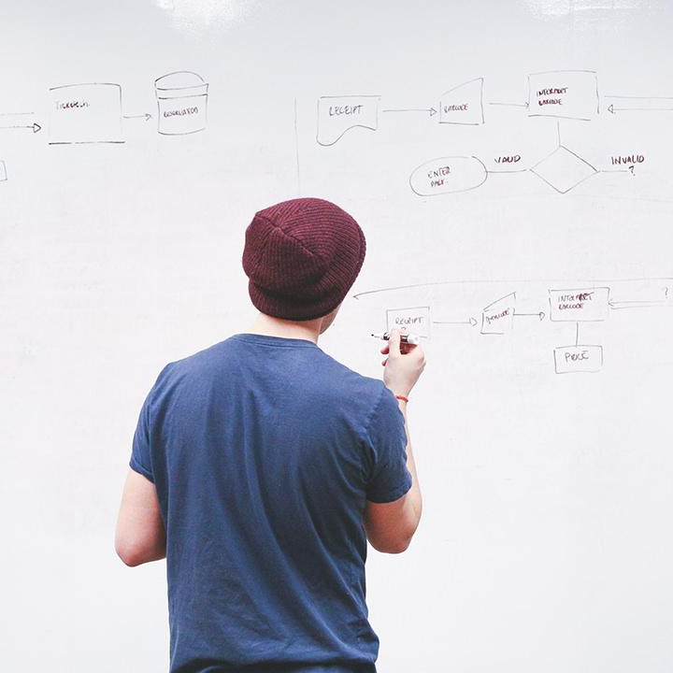
HELLO!
I am Veena Kumaran
(Business Analyst and Freelancer)
You can find me at @VeenaKumaran27@gmail.com

Slide 3
You Will Learn...........
What is ReactJs
Why ReactJs?
Prerequisites to learn ReactJs
Buzzwords around ReactJs

Slide 4
What is ReactJs?
1

Slide 5

What is ReactJs?
ReactJs is a JavaScript library used for building fast and interactive user interfaces
It was developed by Facebook in the year 2011
Current version in use is 16.7.0
ReactJs follows a component based architecture

Slide 6
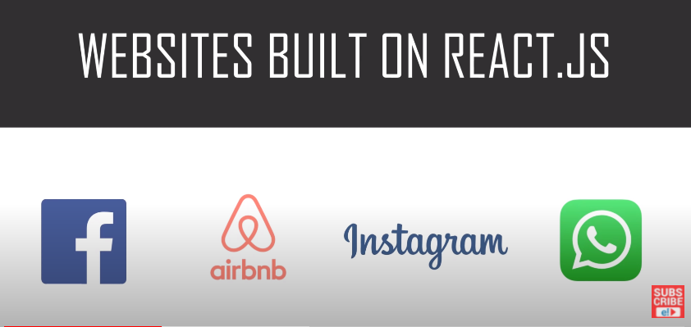
Websites built on ReactJs

Slide 7
Component Based Architecture
Component is a piece of the UI which is independent, isolated and reusable

Slide 8
State and Render methods
State() → describe the state of the element that is displayed (data)
Render() → describes what the UI should look like (component structure)

Slide 9
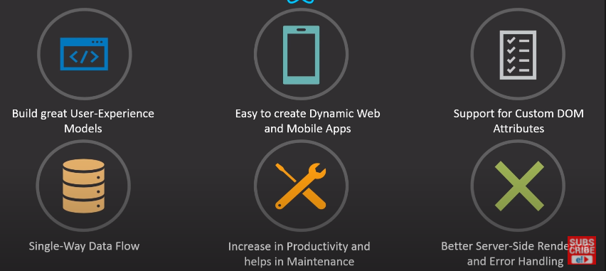
ReactJs Features

Slide 10
Why ReactJs?
2

Slide 11
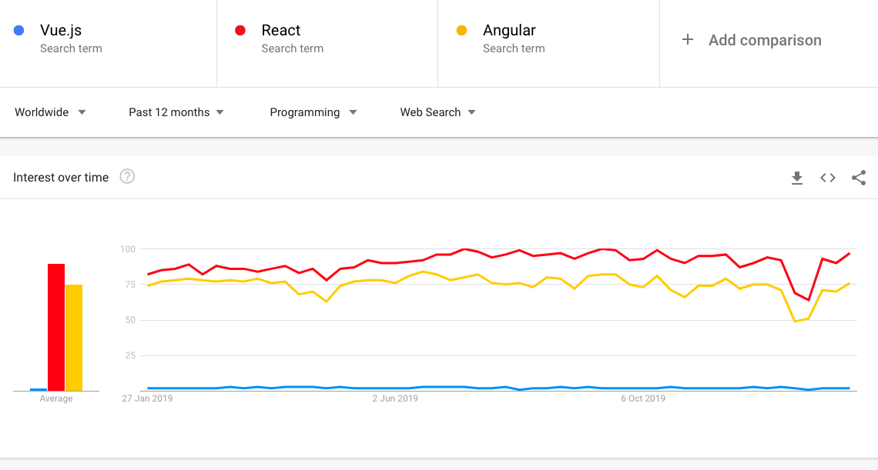
Trends – numbers speak for themselves

Slide 12
Prerequisites
3

Slide 13
Prerequisites
HTML
CSS
JavaScript
JSX
JSON
API

Slide 14
BuzzWords
4

Slide 15
MVC – Model View Controller
View
Model
Controller

Slide 16
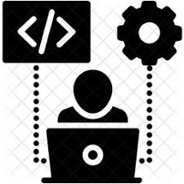
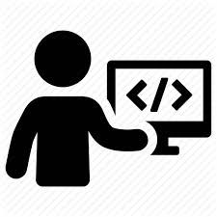
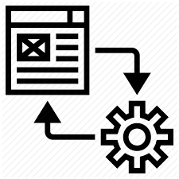
Full Stack
FULL STACK DEVELOPER
CLIENT SIDE
Web Application
HTTP REQUEST
SERVER SIDE
Business Logic
DataBase
API
HTTP RESPONSE
Front End Developer
Back end Developer
Query Languages

Slide 17
MEAN Stack vs MERN Stack
MEAN Stack
Mongo DB
Express Js
Angular Js
Node Js
MERN Stack
Mongo DB
Express Js
React Js
Node Js

Slide 18
Redux
Open Source Js library for managing the state of the objects/application

Slide 19
ENVIRONMENT SETUP

Slide 20
You Will Learn...........
Inspect React Pages
Install node.js
Create basic React app in primitive way
Create basic React app in modern way

Slide 21
Inspect React Pages
We can inspect React pages using the React Console present as an extension for all the browsers
Download React developer tools :
Search chrome extensions in browser >> chrome web store >> Search ‘React Developer tools’
Add this extension to chrome

Slide 22
Environment Setup
Node.js → Node is a server side cross platform (runtime environment) build on google chrome V8 engine for building fast and scalable n/w applications
Node is basically a collection of packages.
NPM → Node Package Manager
NPM is an interface to Node Js
Online Repo for Node Js packages/modules
Command line utility for Node.js packages
Node.js
package1
package3
package2
NPM
Local System

Slide 23
Environment Setup – Primitive Way
STEP 1 : Install Node
STEP 2 : Create a root folder manually in the required directory
STEP 3 : Generate the package.json file
STEP 4 : Install the Packages
> npm init
> npm install react --save
> npm install react-dom --save

Slide 24
Webpack and Babel
Webpack → module bundle used for setting the development server
Used for setting or changing the port for local host
Babel → Plugins required for Webpack
For eg : transpiler , compiler

Slide 25
Environment Setup – Primitive Way
STEP 5 : Install Webpack and Babel
STEP 6: create the required files : Index.html, Index.js, App.js and main.js
Once webpack-config file is generated, paste the default code in it to make it compatible
> npm install webpack --save
> npm install webpack-dev-server --save
> npm install webpack-cli --save
> npm install babel --save
> type nul > webpack-config.js

Slide 26
Environment Setup – Advanced Way
STEP 1 : Install Node
STEP 2 : Navigate to the required location(mainly as administrator) and launch the cmd prompt
The First command is used to install the create-react-app package from Node
Second command is used to create a react application without any build configuration and will create a project with all the required folders
> npm install –g create-react-app
> create-react-app nameofthefolder

Slide 27
BIG CONCEPT

Slide 28
THANKS!
Any questions?

